Slide 1

22AIE457 – Full Stack Development
Real Estate Web Application Using MERN Stack
Batch A, Group – 8
Under the Guidance of
Dr. Sachin Kumar S
Amrita Vishwa Vidyapeetham | 2024

Slide 2

Team Members:
CB.EN.U4AIE21067 | Hari Priya Suda
CB.EN.U4AIE21068 | Sumanjali Sykam
CB.EN.U4AIE21052 | S Likhitha Shree
CB.EN.U4AIE21050 | Hema Radhika

Slide 3
Problem Statement:
To develop a streamlined platform where real estate stakeholders (buyers, sellers, and administrators) can efficiently interact and perform essential tasks such as searching, listing, and managing properties.
Provide tools for buyers to discover properties, sellers to manage their listings, and administrators to ensure smooth operations.

Slide 4
Introduction:
The Real Estate Project is a full-stack web-based application that provides functionality for managing real estate activities, from listing properties to connecting buyers and sellers.
This platform incorporates modern web development technologies, including MongoDB, Express.js, React.js, and Node.js, alongside tools like Firebase and Appwrite for file storage and authentication.
The application focuses on ease of use, allowing buyers to search properties, sellers to upload detailed listings, and admins to oversee system performance and security.
The system is modular, ensuring scalability for future enhancements, such as integrating payment systems, multilingual support, or machine learning-based property recommendations.

Slide 5
Objectives:
Advanced Search and Filtering Options: Provide a real-time search experience through implementing filters for price range, property type (rent/sale), offer and amenities like parking, furnished.
Enable Property Listings with Image Uploads: Allow sellers to create, update, and delete property listings with detailed information such as price, location, type, amenities, and images. Use Firebase and Appwrite for reliable, secure storage of uploaded property images and login details.
Secure User Authentication: Leverage OAuth for quick login with Google accounts and custom login for enhanced flexibility.Implement role-based access controls to restrict functionalities based on user roles (Buyer, Seller, Admin)
User Dashboard for Property Management: Provide an intuitive interface for sellers to view and manage their property listings. Enable buyers to save favorite listings, track inquiries through email

Slide 6
System Architecture:
Components:
Frontend: Built using React.js, offering a responsive and interactive interface. Styled using Tailwind CSS, ensuring a modern and clean UI.
Backend: Developed using Node.js and Express.js to handle server-side logic and API creation. APIs for CRUD operations, user authentication, and search functionalities.
Database: MongoDB for user data, property listings, and activity logs.
Cloud Storage: Firebase and Appwrite to manage secure image and file storage.
Google OAuth: For secure user login.

Slide 7






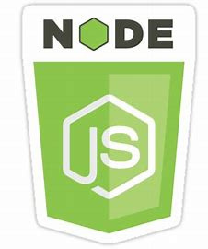


TECH STACK

Slide 8
Workflow:
User Actions:
Buyer: Search properties, view details, schedule visits, save favourites.
Seller: Create/update/delete property listings, upload images, respond to inquiries.
Admin: Manage users, monitor listings.
System Workflow:
Authentication: User logs in using OAuth or custom credentials.
Dashboard: Users access personalized dashboards (listings for sellers, saved properties for buyers).
Search: Buyers filter listings using price range, property type, amenities like furnitures etc.
CRUD Operations: Sellers manage property listings; Admins control platform integrity.
Communication: Messaging system(email) facilitates interaction between buyers and sellers.

Slide 9
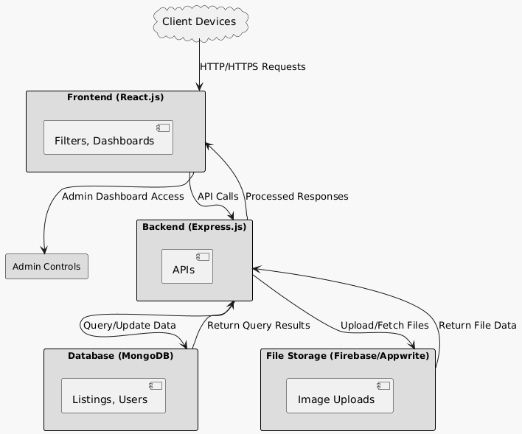
System Flow Diagram:

Slide 10
HEADER SECTION

Slide 11
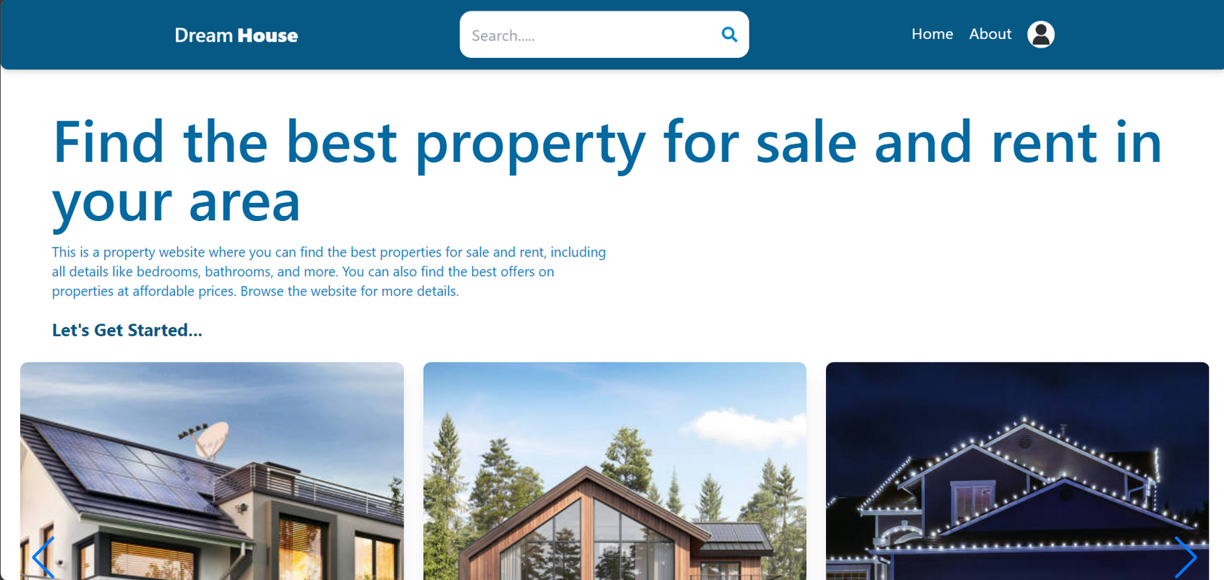
HOME SECTION

Slide 12
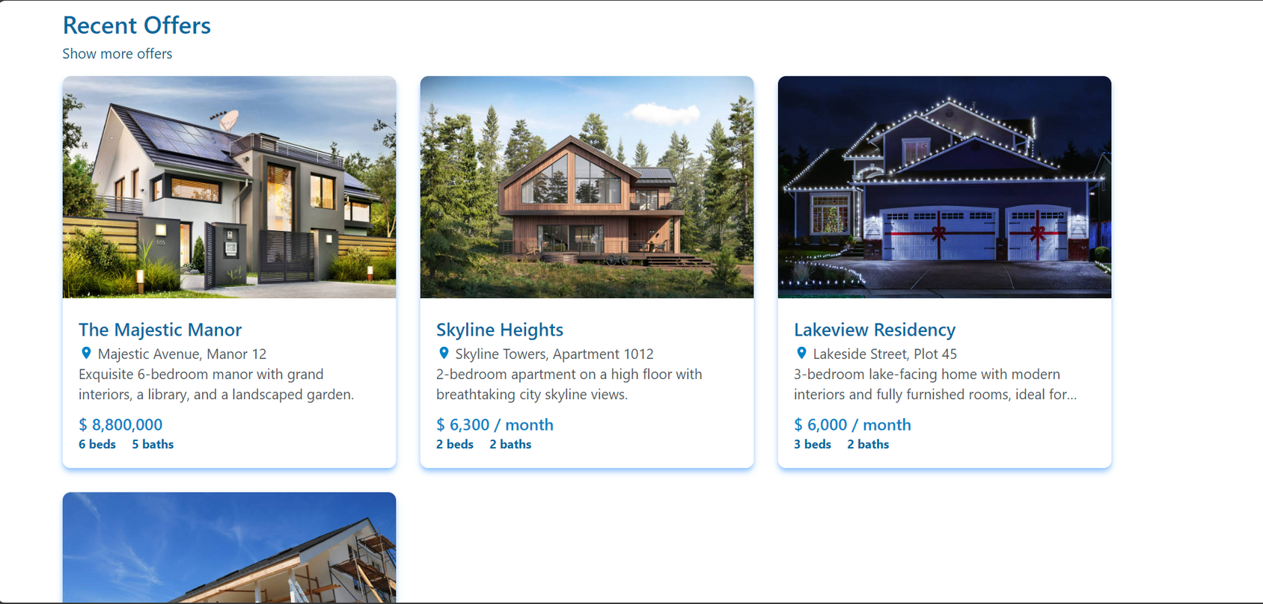
HOME SECTION

Slide 13
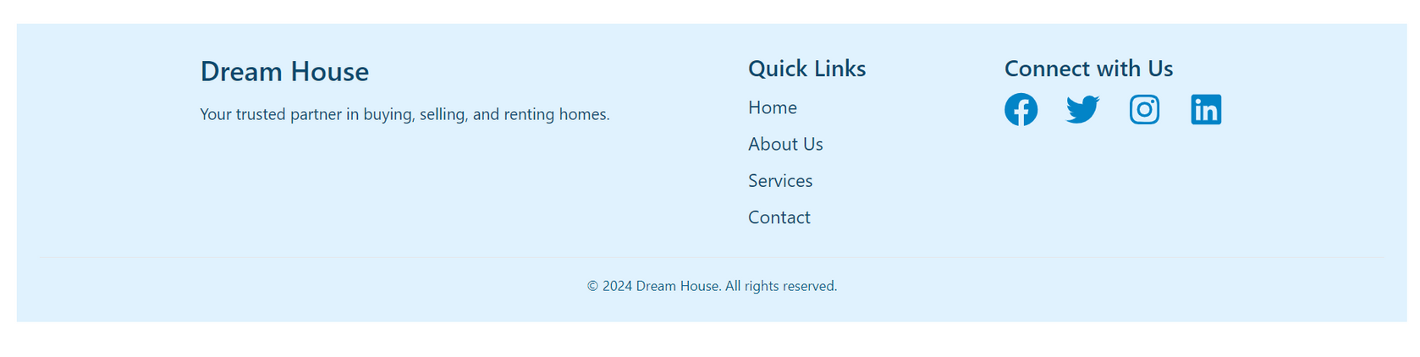
FOOTER SECTION

Slide 14
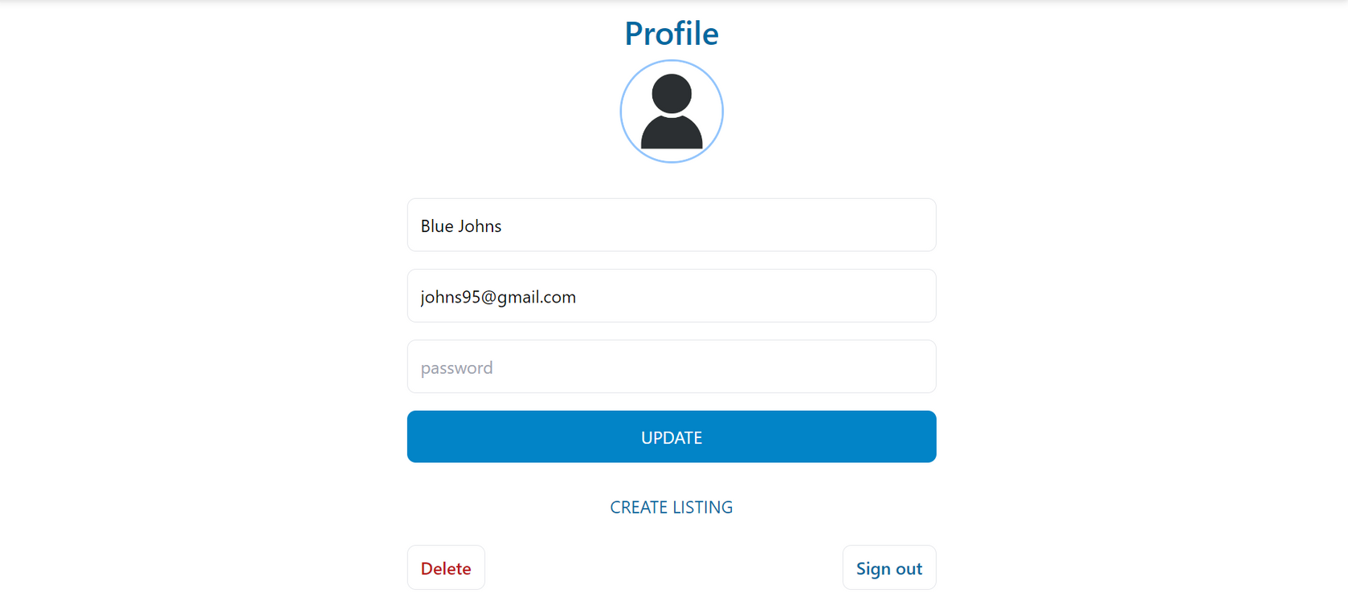
PROFILE SECTION

Slide 15
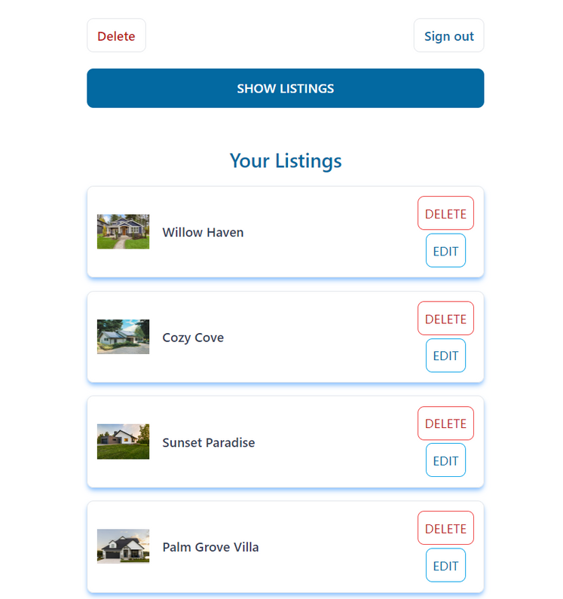
USER LISTINGS SECTION

Slide 16
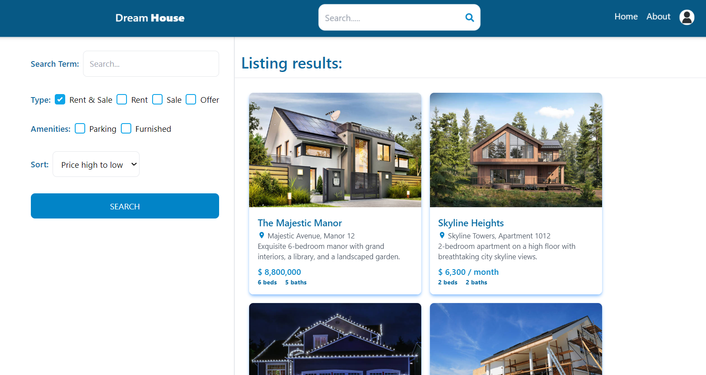
SEARCH SECTION

Slide 17
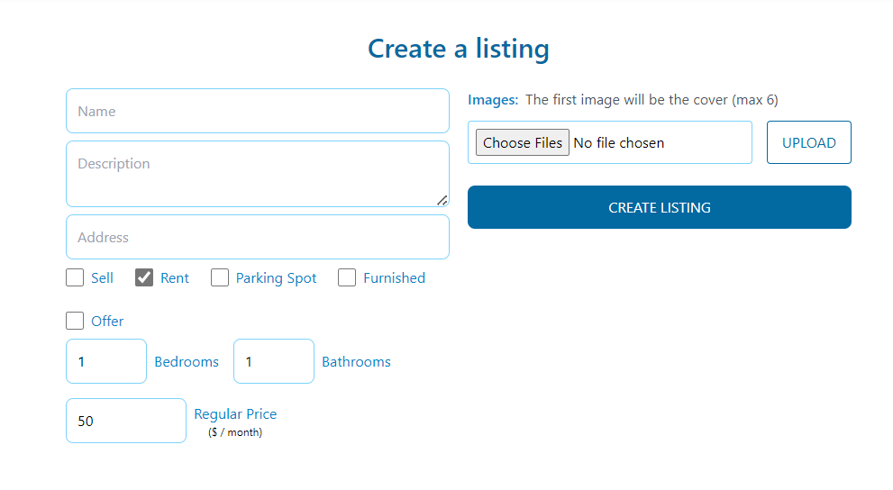
CREATE LISTING SECTION

Slide 18
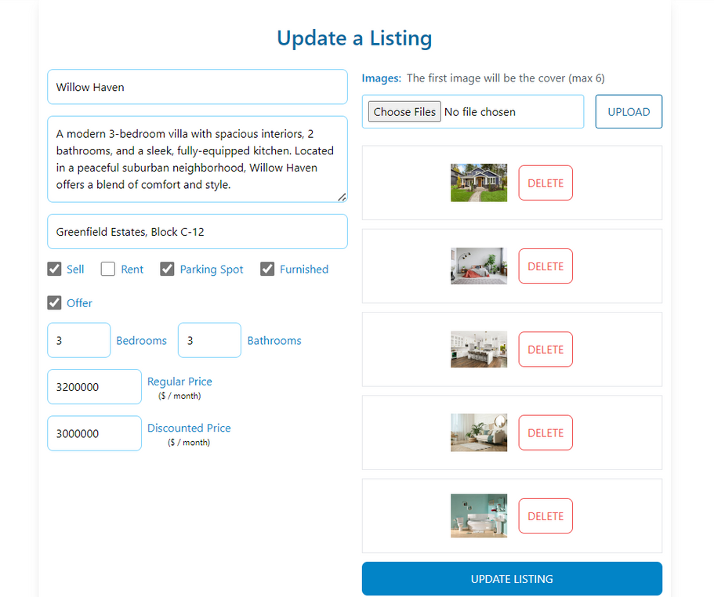
UPDATE LISTING SECTION

Slide 19
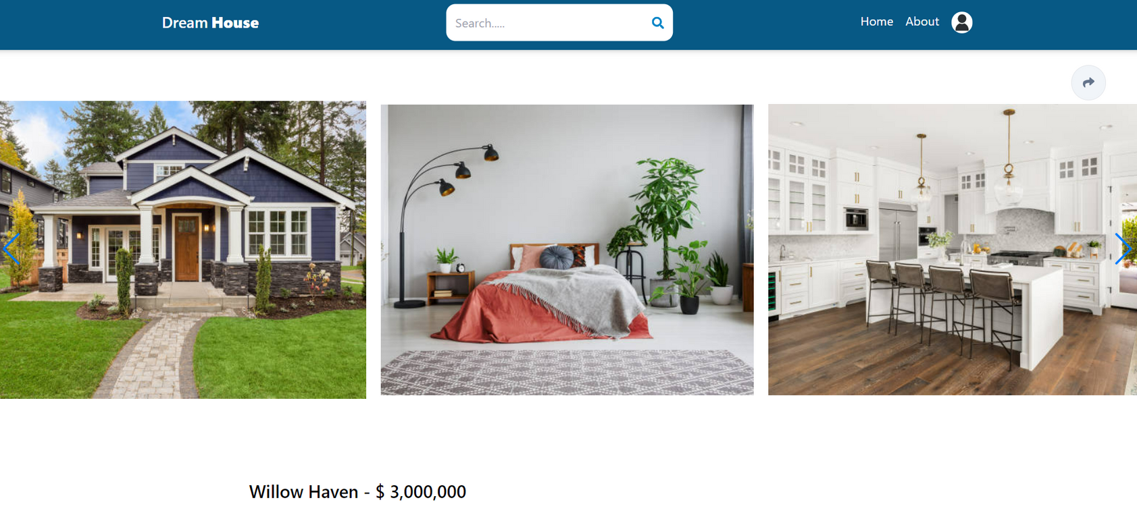
LISTING PAGE SECTION

Slide 20
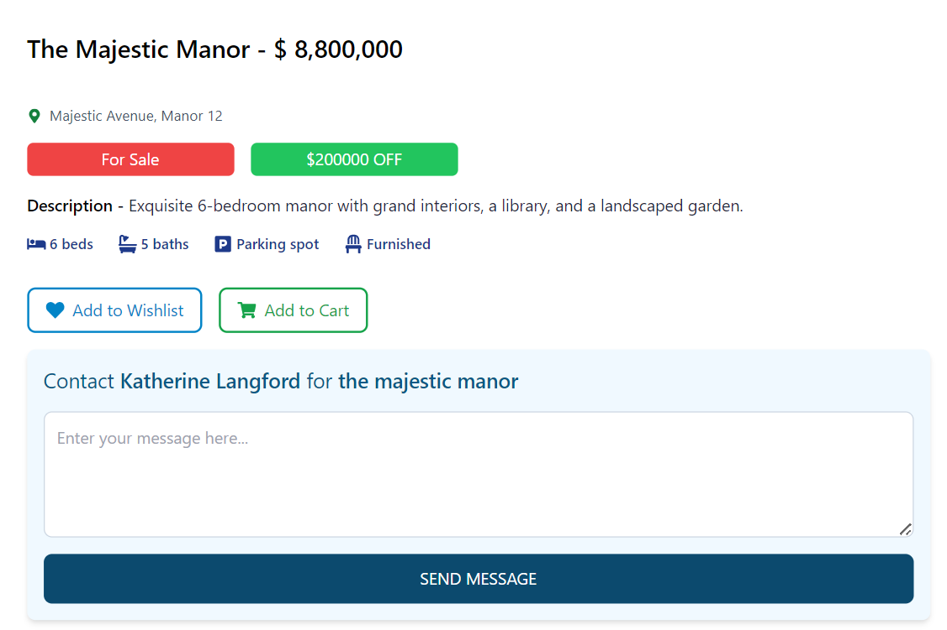
LISTING PAGE SECTION

Slide 21
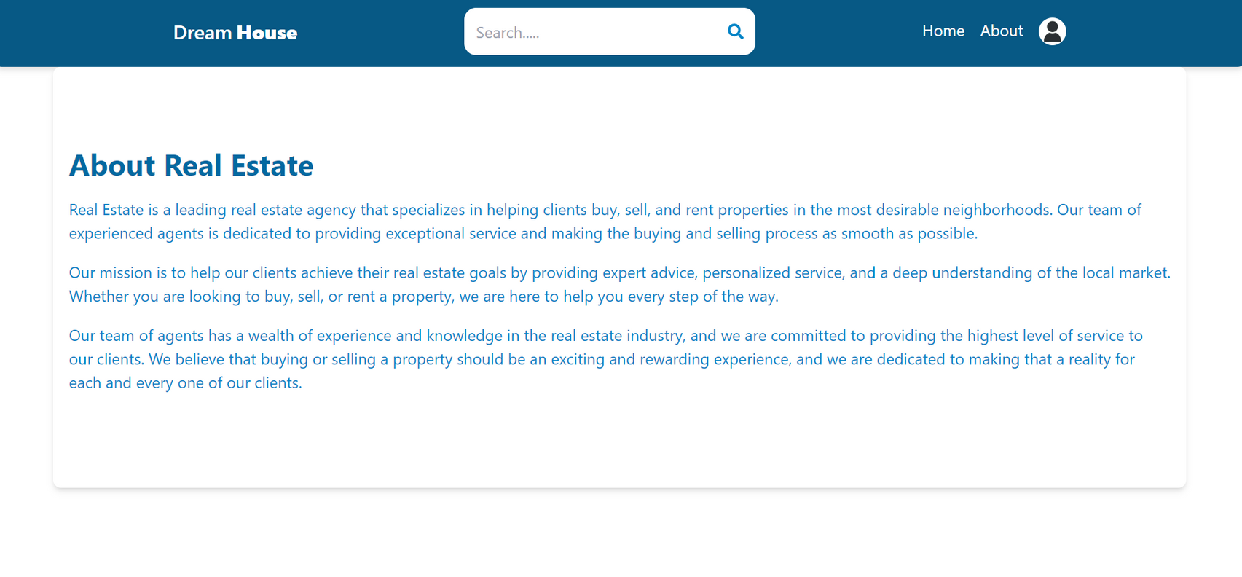
ABOUT SECTION

Slide 22
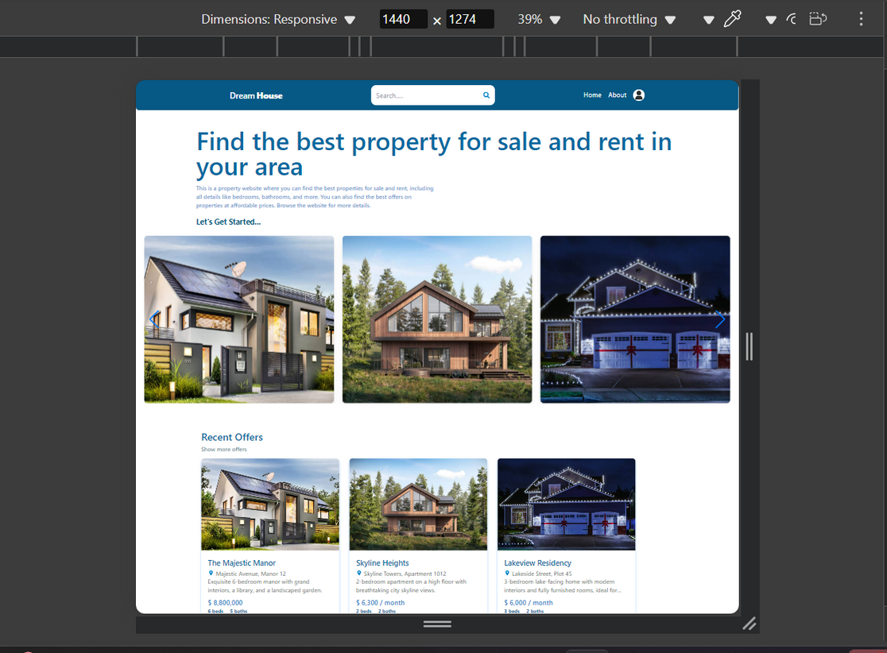
RESPONSIVE DESIGN: LARGE SCREENS

Slide 23
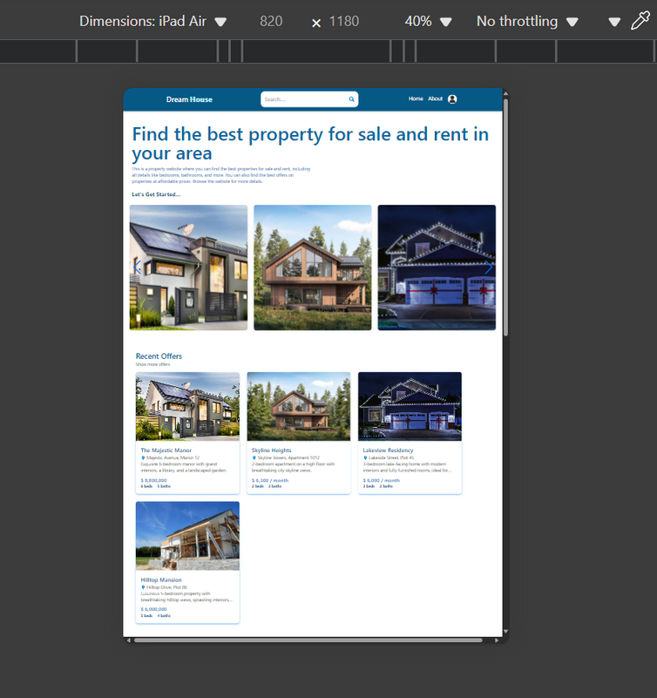
RESPONSIVE DESIGN: MEDIUM SCREENS

Slide 24
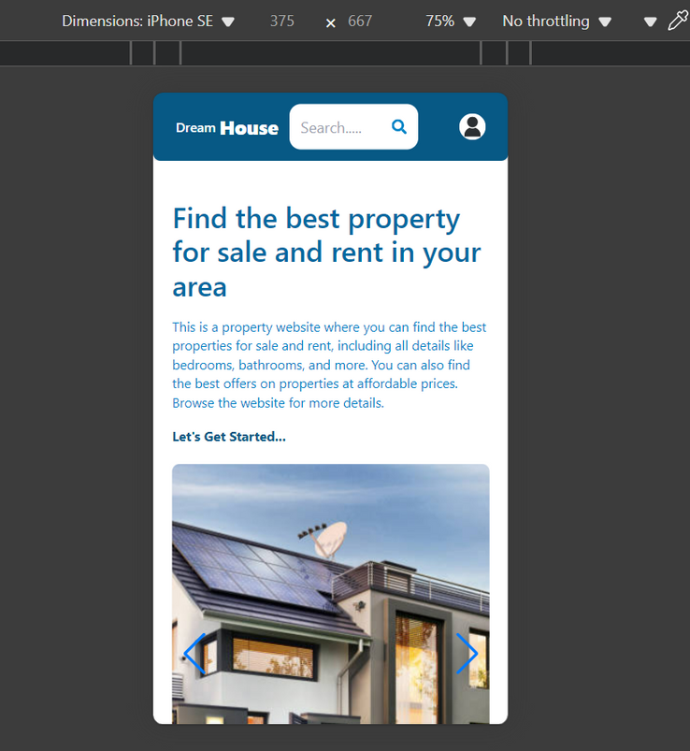
RESPONSIVE DESIGN: SMALL SCREENS

Slide 25
Key Challenges:
Integrating frontend and backend using postman API while testing data retrieval from backend
In order to maintain the user and listing state between different pages of website, we had to learn redux.
Securing user data with OAuth and custom authentication mechanisms while maintaining ease of use.
Protecting the platform from common threats like SQL injection, cross-site scripting (XSS), and data breaches.
Coordinating between sprints while meeting project deadlines, especially when unexpected issues arose, was a significant challenge.

Slide 26
Conclusion:
The Real Estate MERN Stack project successfully delivers a user-friendly platform for buyers, sellers, and administrators, offering features like property management, advanced search, and secure authentication. Leveraging modern technologies and Agile methodology, the project ensures scalability, efficiency, and adaptability, laying a strong foundation for future enhancements.

Slide 27
THANK YOU

